Slide 1
EMPLOYEE RETENTION ANALYSIS
(Team No 10)
PRASHANT MURAL
SANKET WAGHMARE
SHASHANK TELKHADE
SHIKHAR AGRAWAL

Slide 2
PROBLEM STATEMENT
To analyze various factors responsible for the ATTRITION of employees
Finding efficient ways to retain the productive and talented employees

Slide 3
DATASET

Slide 4
DATASET
The data set represents employee reviews from Glassdoor with target value 'Attrition'.
'Yes' - Resign (+ve)
'No' - Doesn't Resign (-ve)
Features include Numerical and Categorical values.
Some level of attrition will always be there, but the company wants to minimize this and keep the best employee from leaving.
The data set is used to run analysis of employees, to find certain “at risk” categories of employees.

Slide 5
DATASET
The dataset consists of 21 columns out which we have selected 14 columns based on our intuition
Also, we added 3 columns for our analysis
Polarity
Subjectivity
NormalizedMarketVal

Slide 6


FEATURE -MARKET VALUATION
For the column CompanyName , the unique companies in the dataset added a new column Marketvaluation
Normalized the values based on maximum
See if this affects attrition
See that f1 score does not change so dropped

Slide 7
SENTIMENT ANALYSIS
For the text 'Reviews' column it is unstructured
Convert to numerical based on the sentiment using TextBlob
Polarity of review ranges from –1 to 1

Slide 8
DATA PRE-PROCESSING
Conversion of Categorical values to Numerical values.
Application of NLP on 'Reviews' for the extraction of highly sentimental data in the given dataset.
Removal of outliers from the data based on sentiment
Highly negative reviews (Polarity), but STAYED (False –ve)
Highly positive reviews (Polarity), but LEFT (False +ve)
Removal of non-sentimental data (data around center)
Optimal center?
Optimal threshold?
Non-subjective?

Slide 9
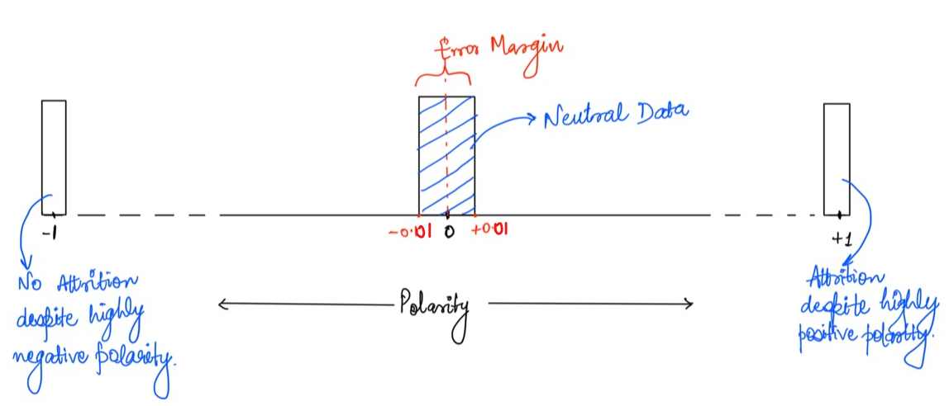
Data pre-processing

Slide 10
DATA FILTERING METHOD

Slide 11
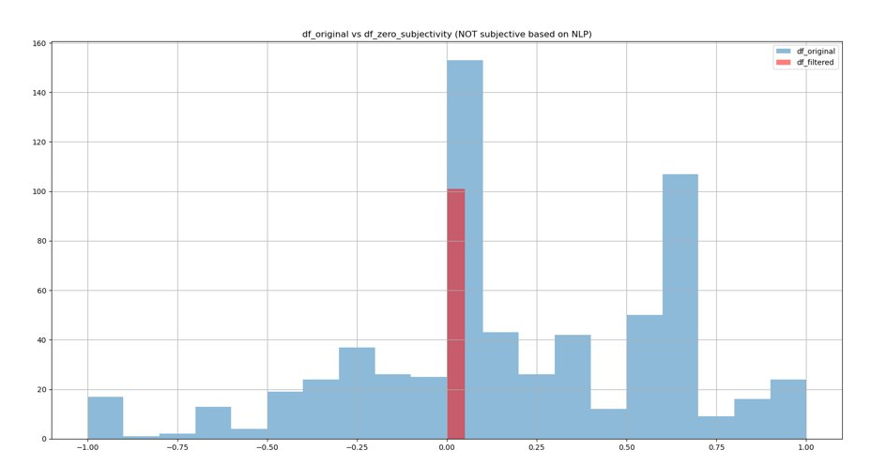
Non subjective data

Slide 12
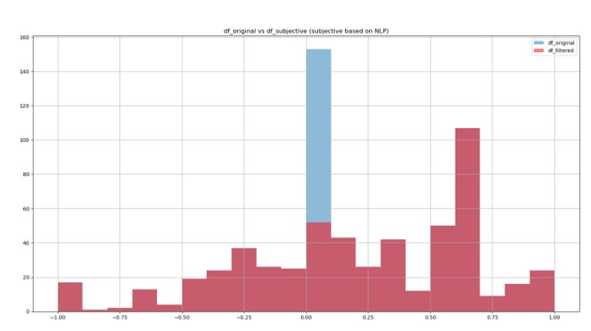
Blue – non-subjective (not considered)

Slide 13
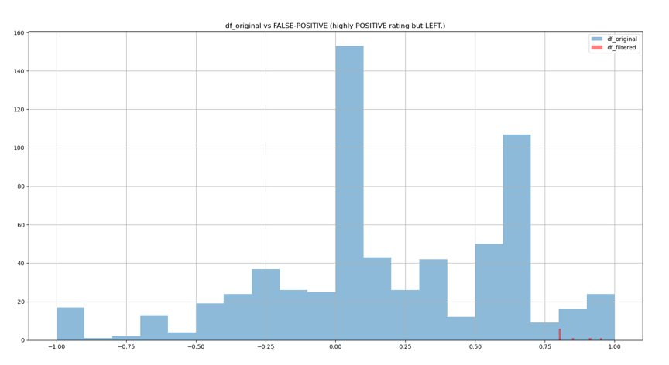
False-positives

Slide 14
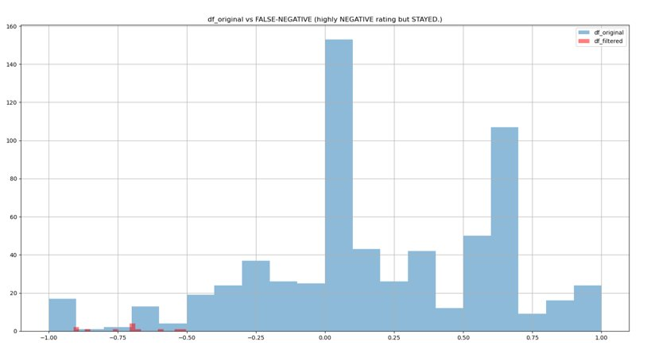
False negatives

Slide 15
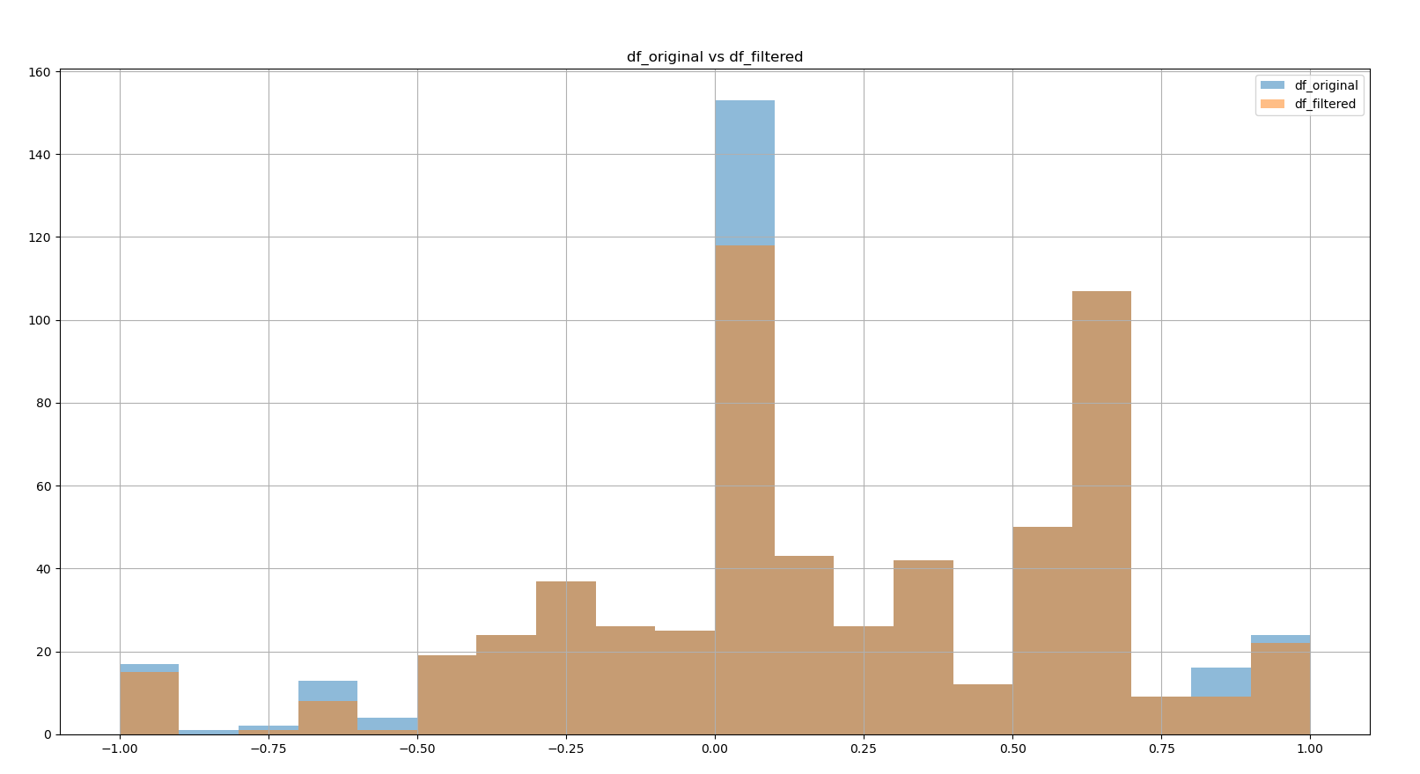
Data original vs data filtered

Slide 16
DATA VISUALISATION

Slide 17
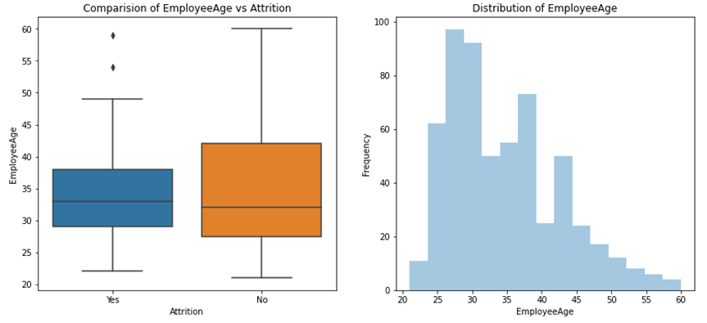
EMPLOYEE AGE VS ATTRITION

Slide 18
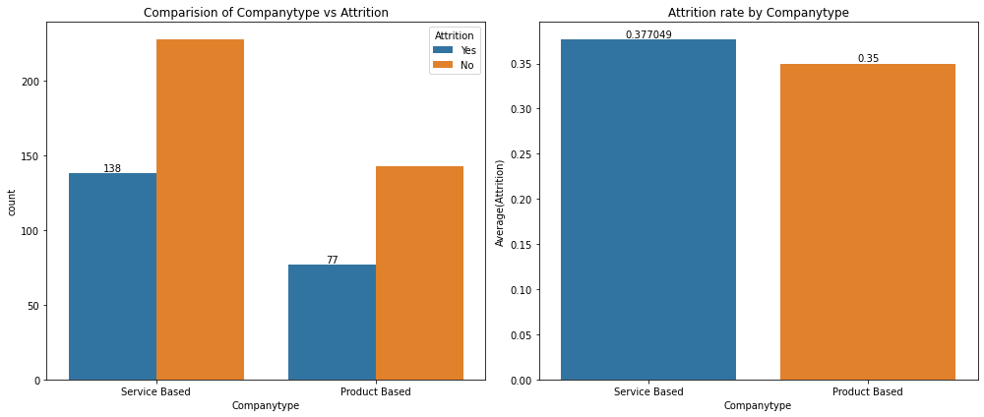
COMPANY TYPE VS ATTRITION

Slide 19
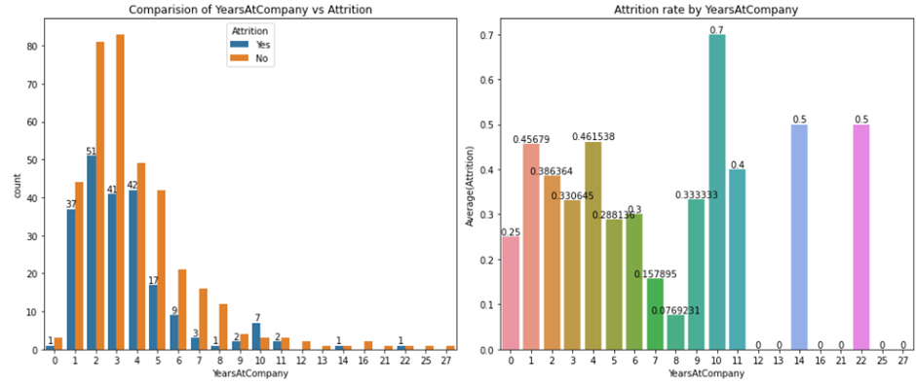
YEARS AT COMPANY VS ATTRITION

Slide 20
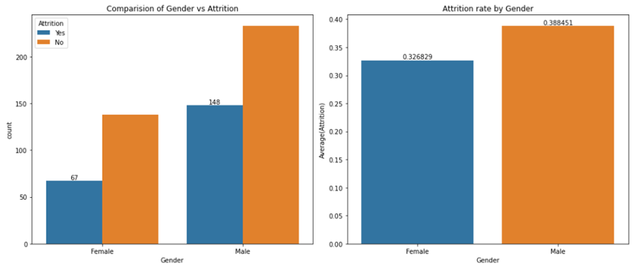
GENDER VS ATTRITION

Slide 21
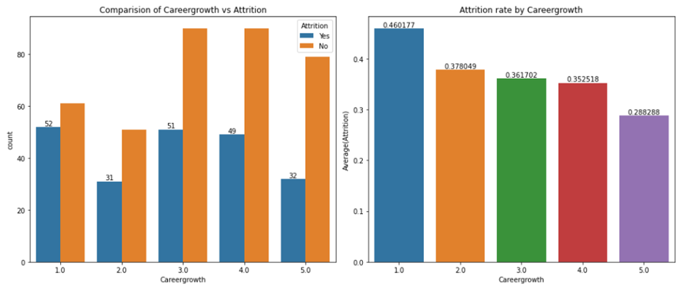
CAREER GROWTH VS ATTRITION

Slide 22
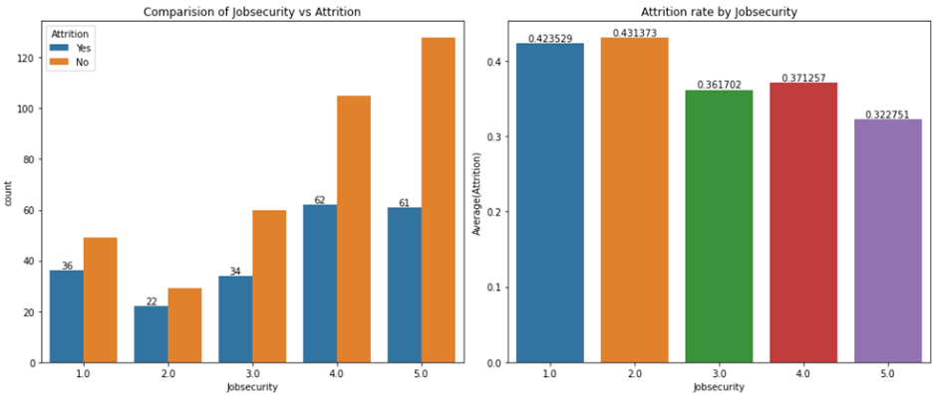
JOB SECURITY VS ATTRITION

Slide 23
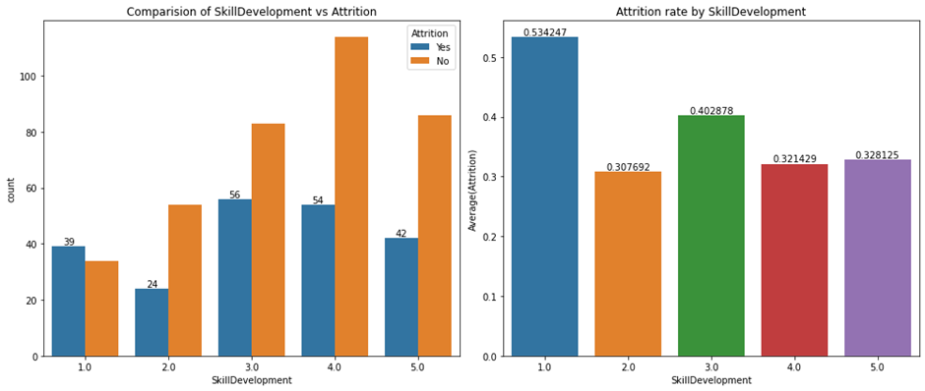
SKILL DEVELOPMENT VS ATTRITION

Slide 24
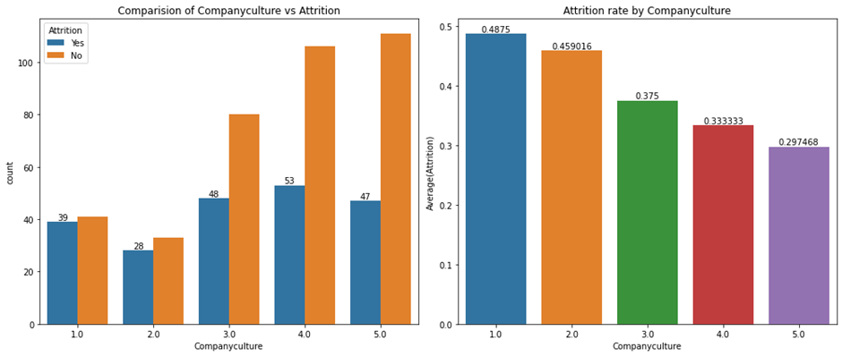
COMPANY CULTURE VS ATTRITION

Slide 25
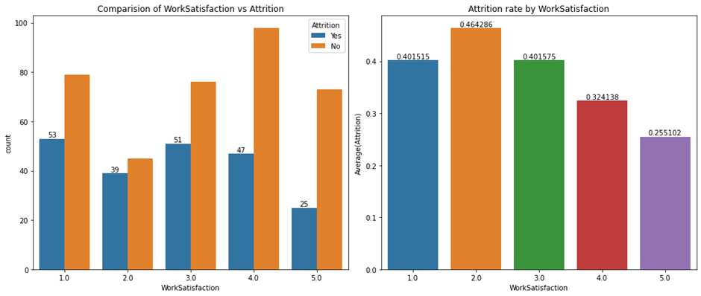
WORK SATISFACTION VS ATTRITION

Slide 26
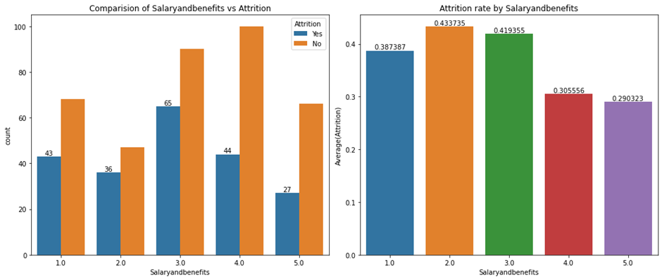
SALARY AND BENEFITS VS ATTRITION

Slide 27
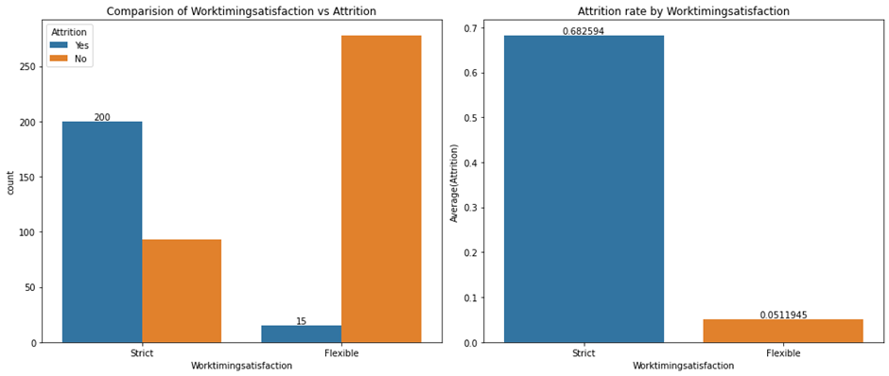
WORK TIME SATISFACTION VS ATTRITION

Slide 28
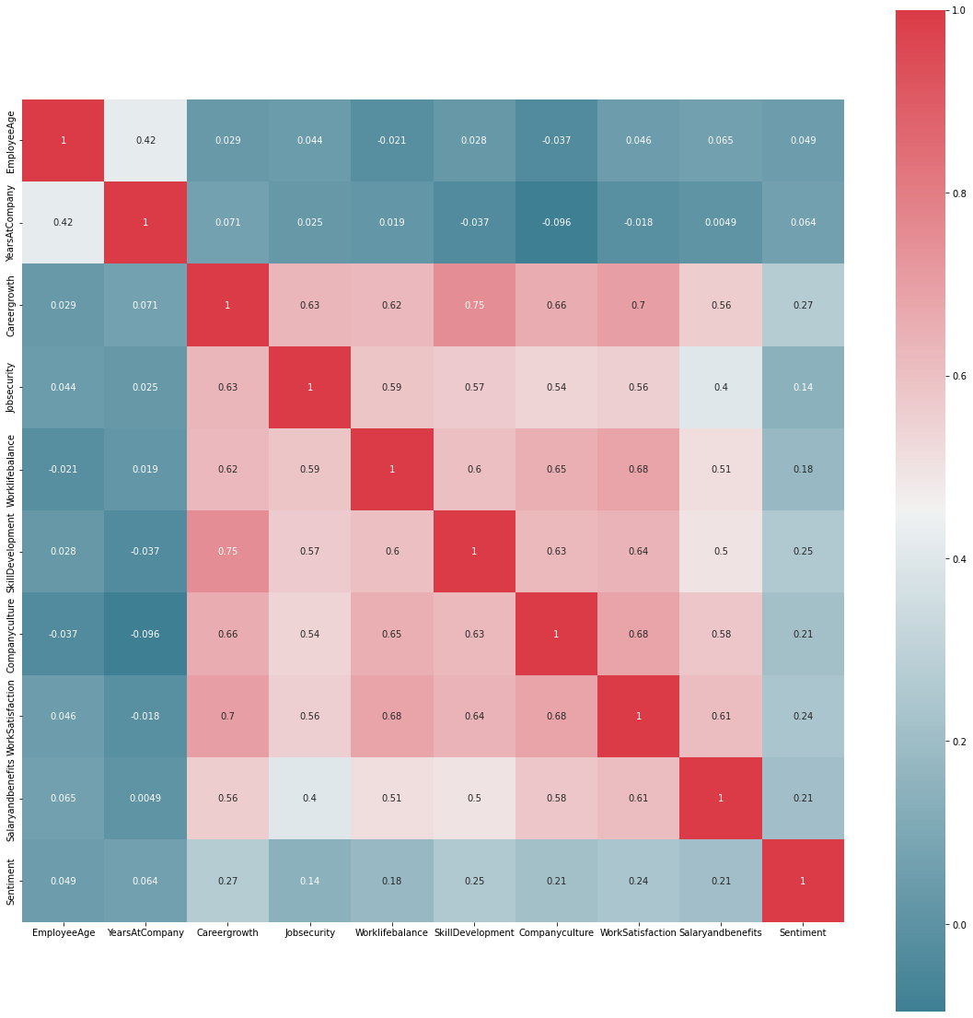
CORRELATION HEATMAP

Slide 29
PREDICTING EMPLOYEE ATTRITION
Decision Tree Classifier
Confusion Matrix
F1- Score

Slide 30
MODELS

Slide 31
WHY DECISION TREES?
For the text 'Reviews' column it is unstructured
We observed that data contained mostly categorical values Thus we considered decision trees
Splitting the data based on Information Gain

Slide 32
WHY DECISION TREES?
Parameters :
Depth of Tree
Minimum Samples at a Node
Criterion – Entropy/Gini Index.
Metrics – Confusion Metrics & F-1 Score

Slide 33
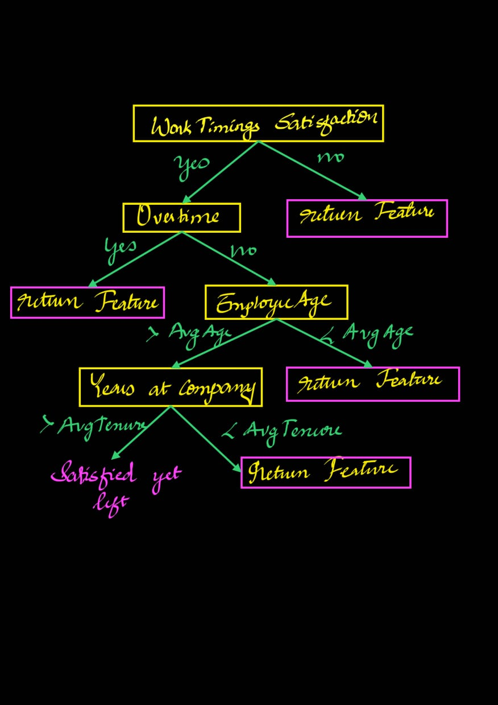
Decision Tree

Slide 34
CONFUSION MATRIX AND F1 SCORE
How good is the Classifier.
F1 Score : 0.9247
Actual vs Predicted ​ | No ​ | Yes​
No​ | 61​ | 6​
Yes​ | 3​ | 35​

Slide 35
RISK PREDICTION
Classifier predicting the probability of 'Attrition
Random Samples of Employees.​ | Risk of Attrition ​ | Reasons ​ | Ground Truth ​
1​ | 0.93​ | Work Time Satisfaction​ | 1​
2​ | 0.33​ | None ​ | 0​
3​ | 0.72​ | Over Time​ | 1​
4​ | 0.93​ | Work Time Satisfaction ​ | 1​
5​ | 0.93​ | Work Time Satisfaction ​ | 1​

Slide 36
EFFECT OF DATA FILTERING
(for various centers, thresholds and features)

Slide 37
Plots for ACCURACY VS DATa POINTS
No Features dropped
Work timings satisfaction dropped
Overtime also dropped

Slide 38
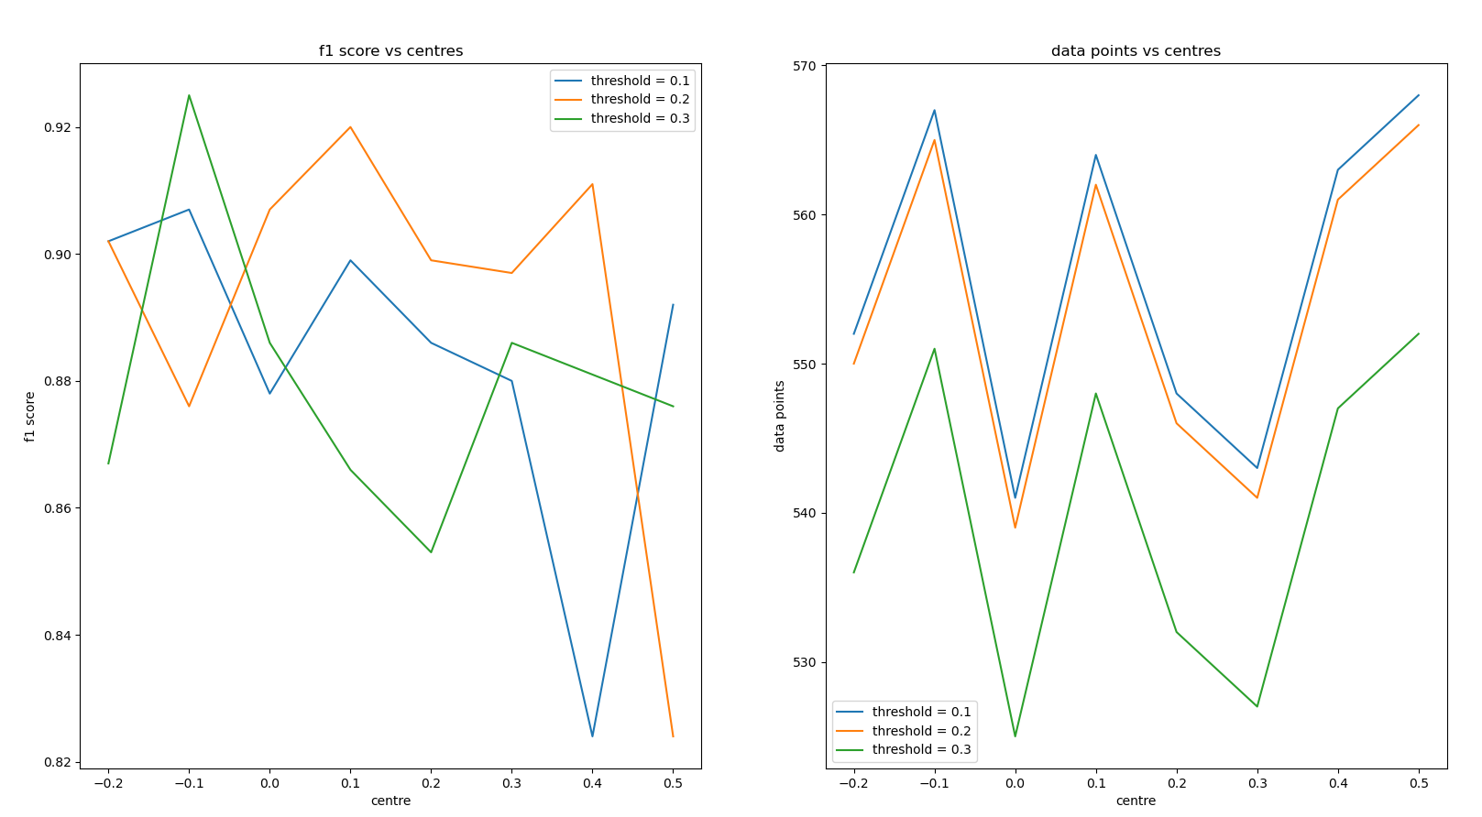
ACCURACY VS DATA POINTS
(all features)

Slide 39
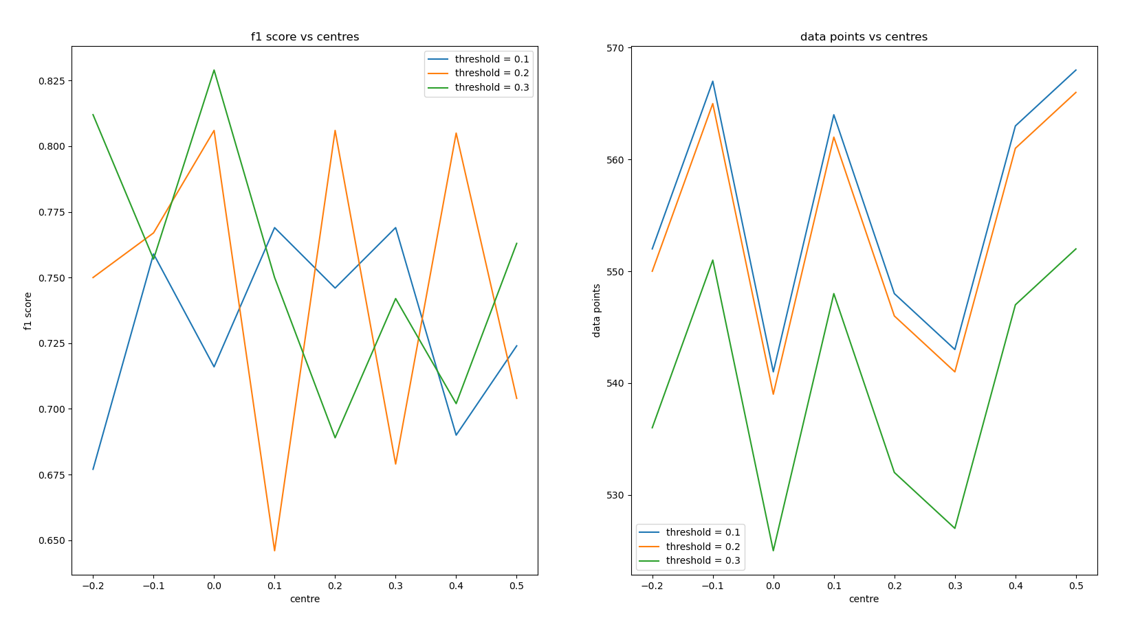
ACCURACY : data points
(WORK TIMINGS SATISFACTION DROPPED)

Slide 40
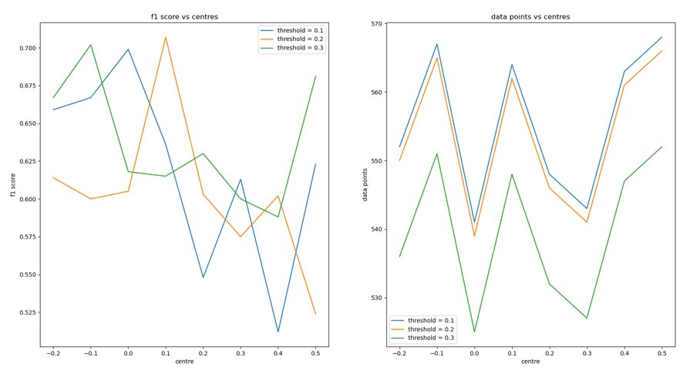
ACCURACY : data points
(Overtime also dropped)

Slide 41
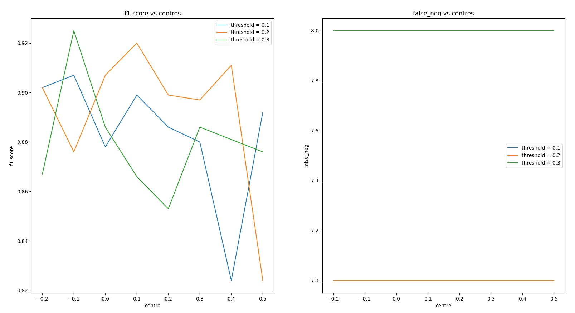
ACCURACY : false -ve
(all features)

Slide 42
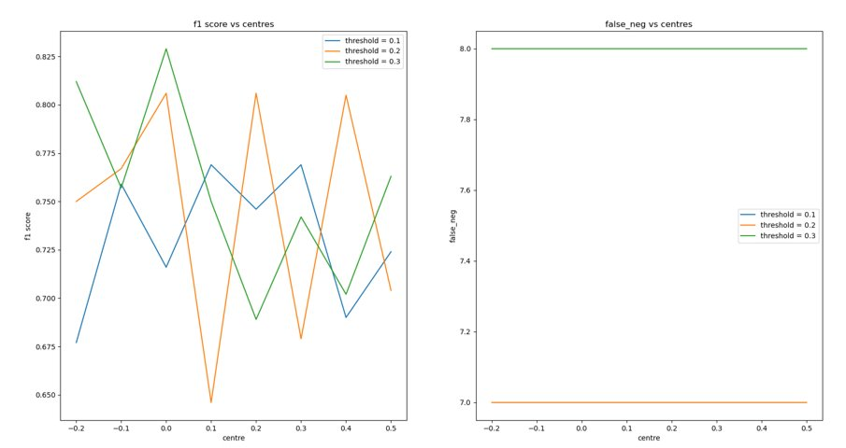
ACCURACY : false -ve
(WORK TIMINGS SATISFACTION DROPPED)

Slide 43
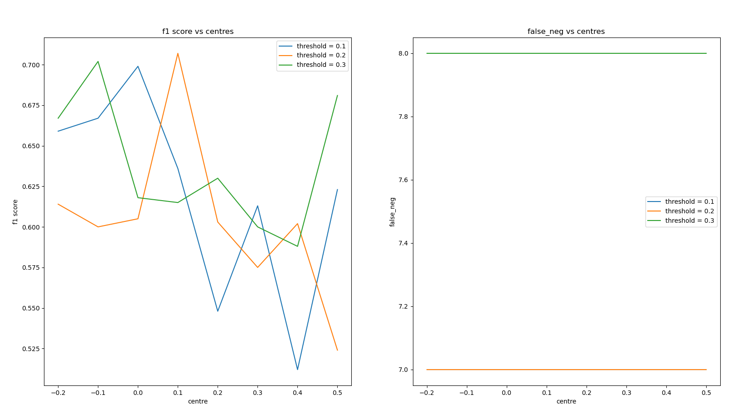
ACCURACY : false -ve
(Overtime also dropped)

Slide 44
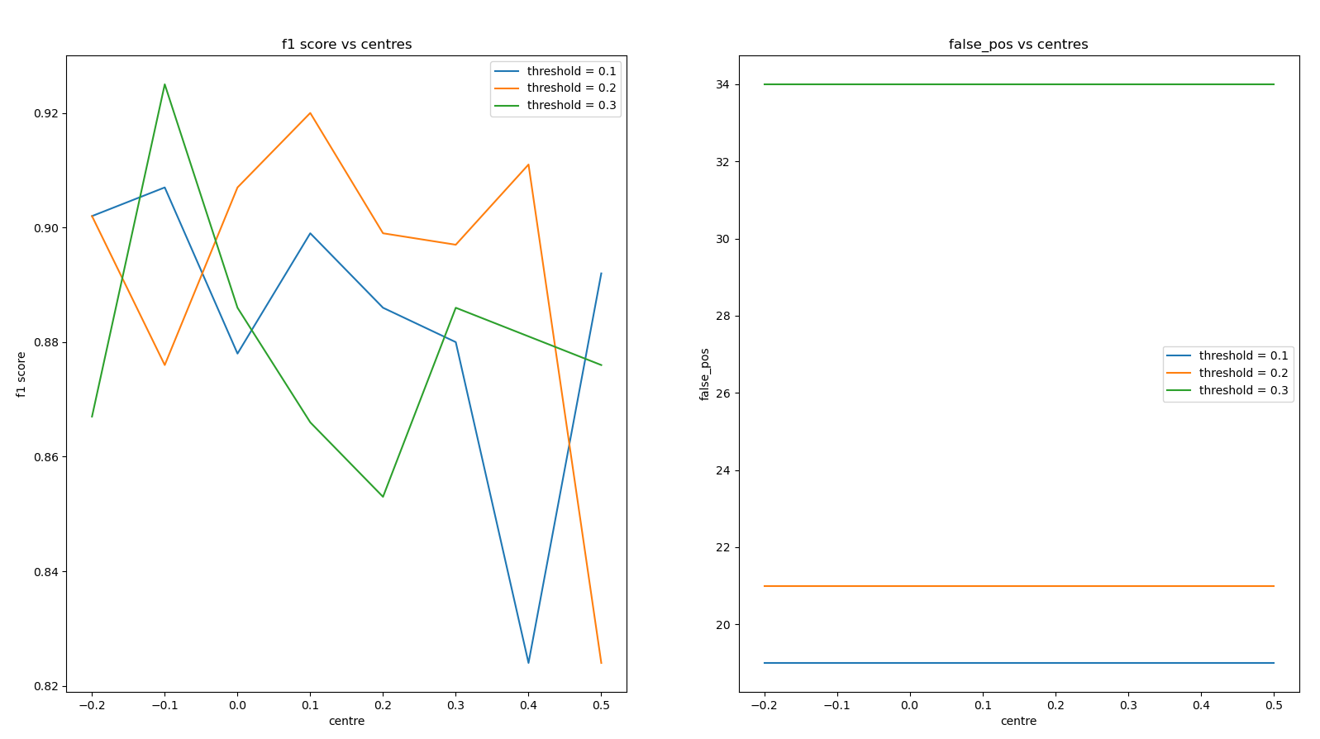
ACCURACY : false +ve
(all features)

Slide 45
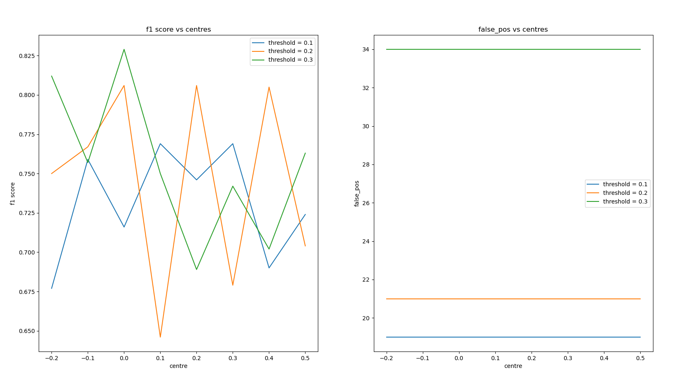
ACCURACY : false +ve
(work timing satisfaction dropped)

Slide 46
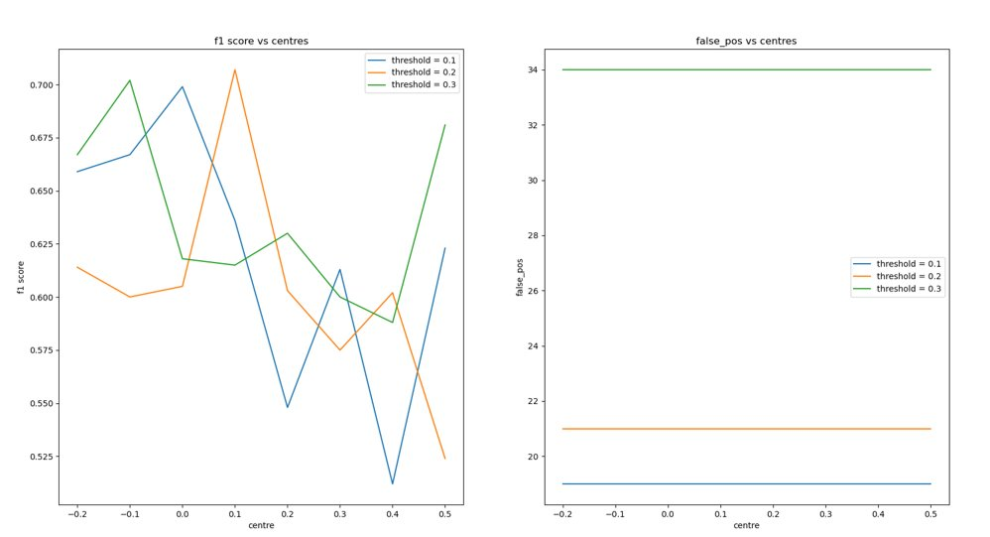
ACCURACY : false +ve
(Overtime also dropped)

Slide 47
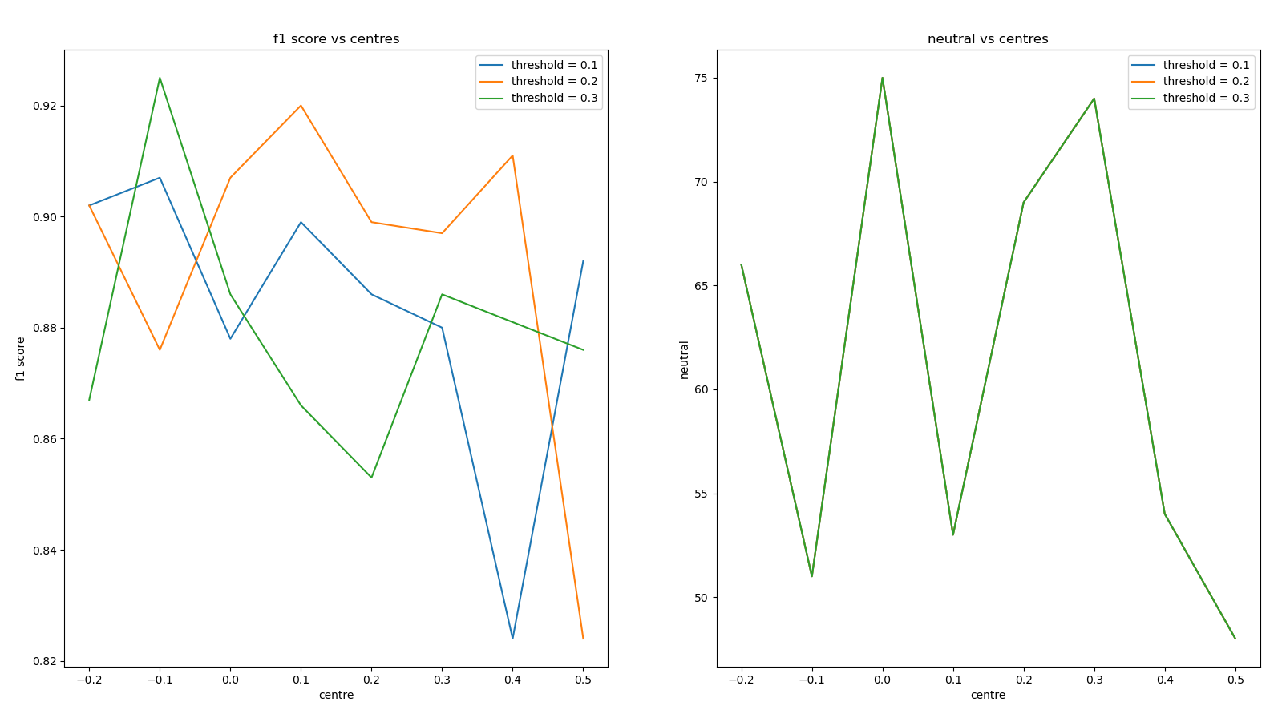
ACCURACY : neutrals
(all features)

Slide 48
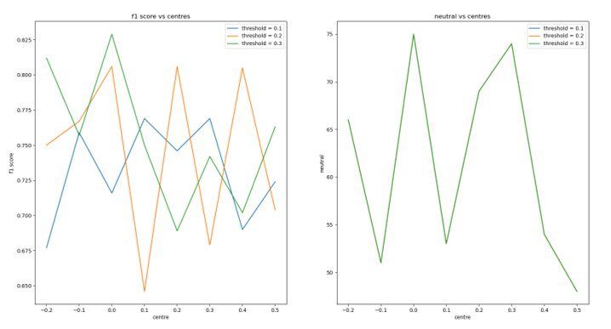
ACCURACY : neutrals
(WORK TIMINGS SATISFACTION dropped)

Slide 49
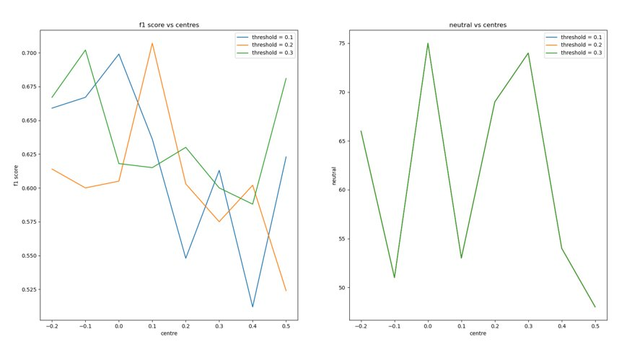
ACCURACY : neutrals
(Overtime also dropped)

Slide 50
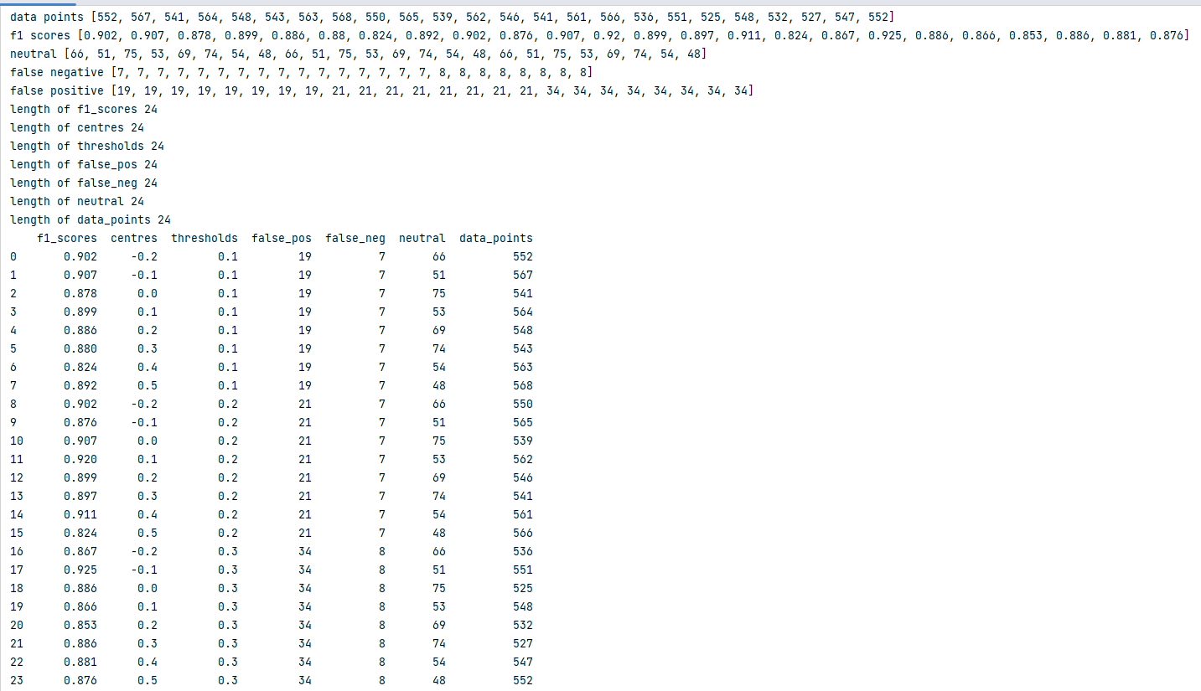
ACCURACY : relevant data
(all features)

Slide 51
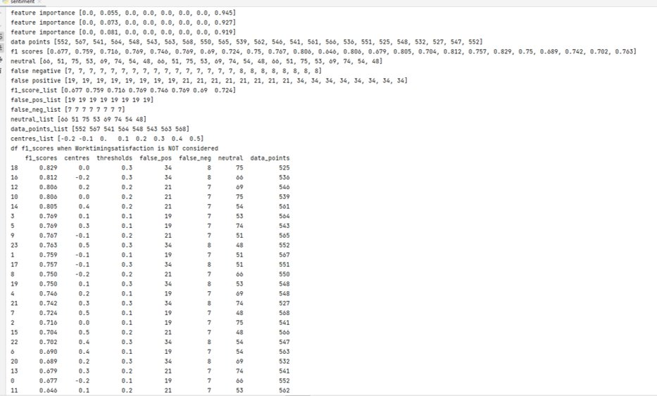
ACCURACY : relevant data
(WORK TIMINGS SATISFACTION DROPPED)

Slide 52
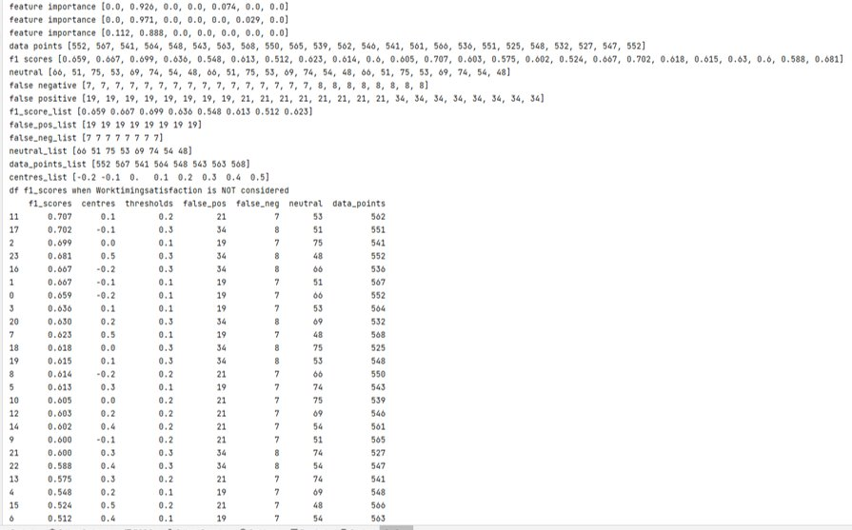
ACCURACY : relevant data
(Overtime also dropped)

Slide 53
CONCLUSION
Since the data was limited and we feel that only employees looking for some changes are visiting these sites like glass door and ambition box, so there is always a natural Bias within the data.
We tried to counter that by leveraging the fact that we had handwritten reviews by the employees, and we looked how subjective each review and did further data filtering to centre the data at appropriate centre for the neutrality of each review and then removed those data points.
The most important factor standing out as the reason for attrition was ‘Work Timing Satisfaction ‘for the employees and followed by how often they are compelled to do Overtime.

Slide 54
REFERENCES
https://doi.org/10.48550/arXiv.2012.01286
Solving Staff Attrition with Data | by Andrew Olton | Towards Data Science
Employee Attrition Analytics: The Who, When & Why Of Employee Turnover | Perceptyx
https://blog.perceptyx.com/news-research-one-third-of-employees-are-working-dead-report
EMPLOYEE ATTRITION DATASET | Kaggle

Slide 55
THANK YOU

